Slide 1

Michigan’s Economic Outlook
Presented to
South Central Michigan Economic Forum
February 29, 2008
Charles L. Ballard
Department of Economics
Michigan State University
East Lansing, MI
ballard@msu.edu

Slide 2
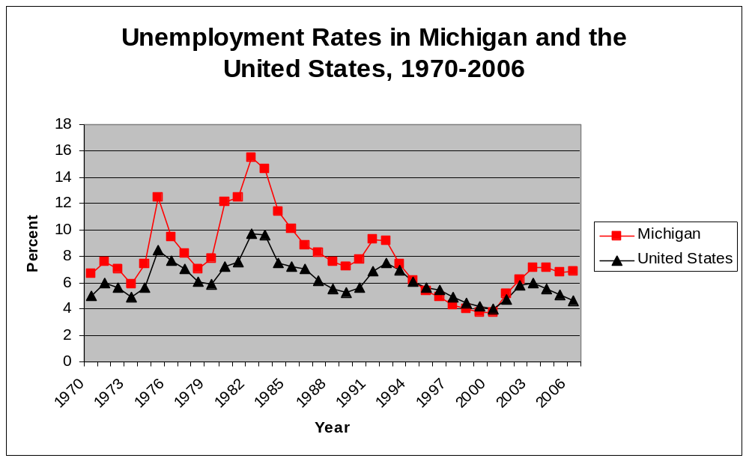
Michigan Unemployment Is Above the National Average, But Low By Historical Standards

Slide 3
And Unemployment in Michigan Has Big Regional Differences (December, 2007)
Ann Arbor 4.7%
Kalamazoo-Portage 5.7%
Lansing-East Lansing 5.7%
Holland-Grand Haven 5.8%
Grand Rapids-Wyoming 6.0%
Battle Creek 6.7%
Michigan Average 7.4%
Jackson 7.6%
Detroit-Warren-Livonia 8.0%
Flint 8.3%

Slide 4
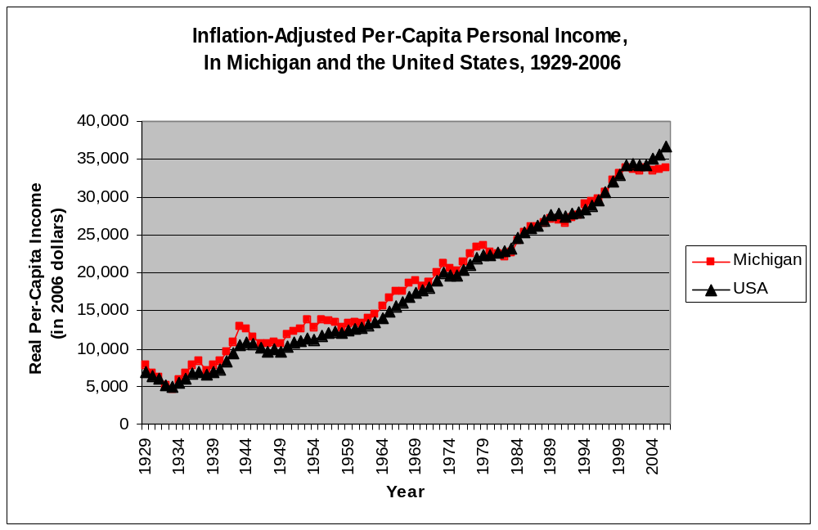
Incomes Really Have Grown,
In Michigan and in the Rest of the U.S.

Slide 5
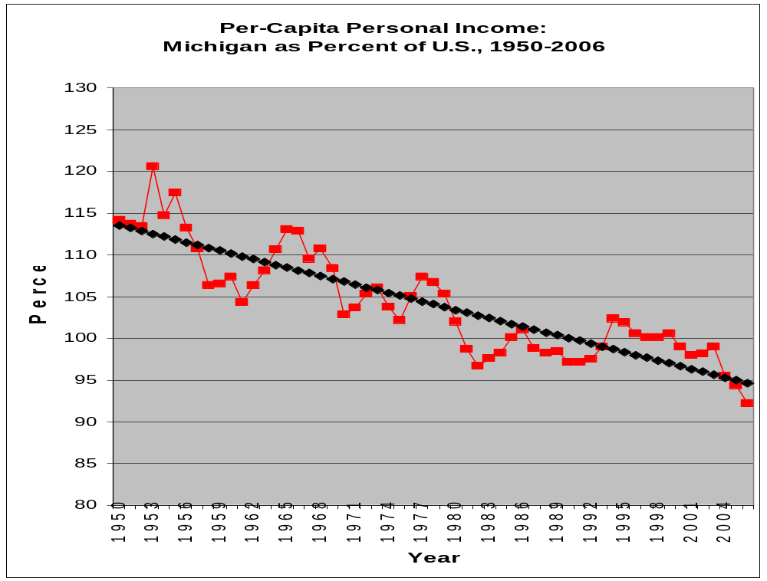
But Income Growth Has Been Slower in Michigan Than the U.S. Average

Slide 6
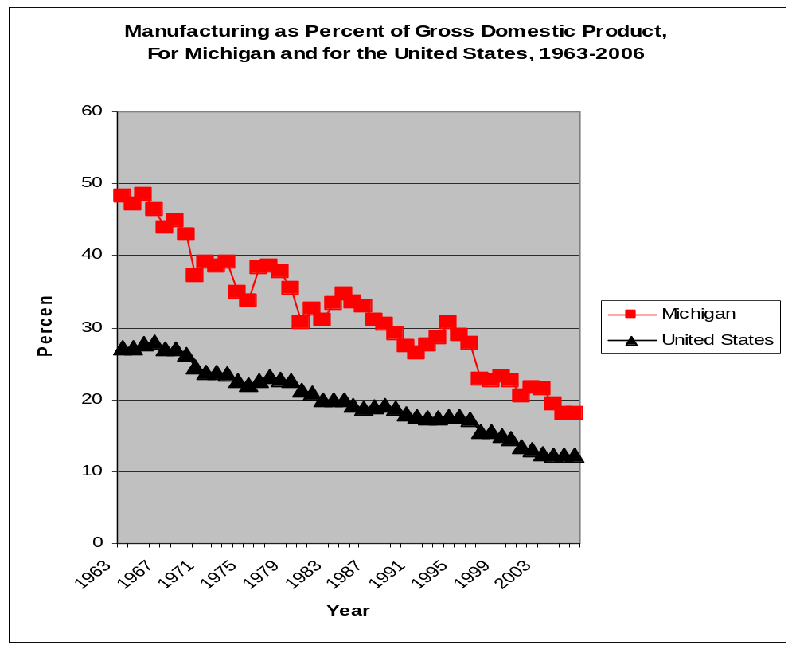
Manufacturing’s Share of the Economy Has Shrunk Dramatically

Slide 7
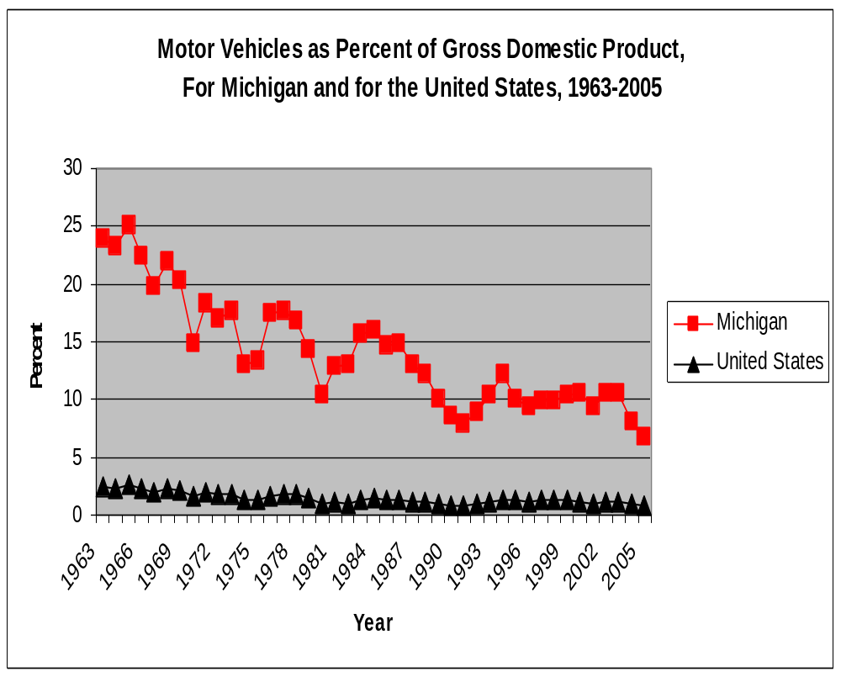
Most of Michigan’s Manufacturing Losses
Are in the Auto Industry

Slide 8
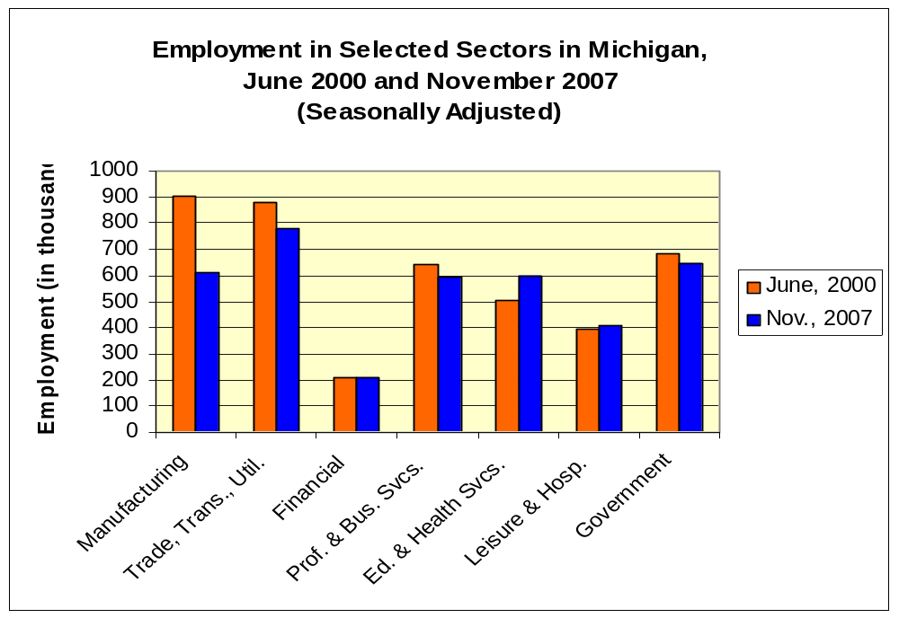
Michigan’s Recent Job Losses Are Concentrated in Manufacturing

Slide 9
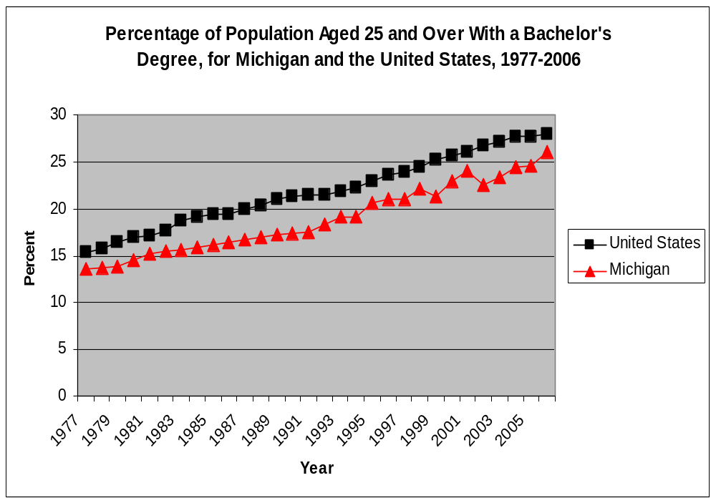
Michigan Lags in College Attainment

Slide 10
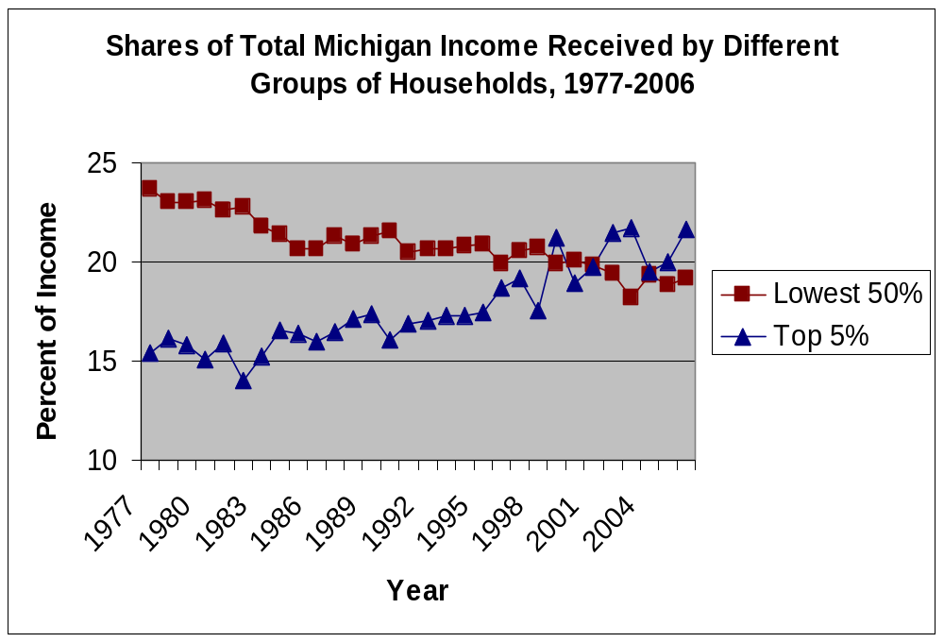
In Michigan, As in the Rest of the U.S., Inequality Has Soared

Slide 11
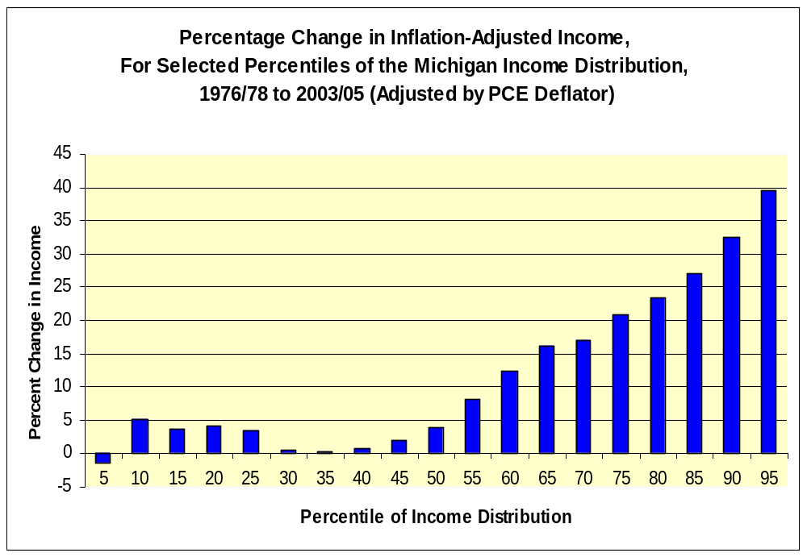
Incomes Have Stagnated for the Bottom Half of the Michigan Income Distribution

Slide 12
Michigan Has Big Regional Differences in Per-Capita Income (Data for 2005)
1. Oakland County $52,274
2. Washtenaw County $39,689
4. Leelanau County $36,502
8. Kent County $33,627
Michigan Average $32,804
9. Kalamazoo County $32,089
13. Wayne County $30,855
27. Calhoun County $28,289
33. Jackson County $27,299
41. St. Joseph County $26,078
47. Hillsdale County $25,208
59. Branch County $23,502
83. Luce County $19,115

Slide 13
What Does the Future Hold for Michigan?
The Long-Term Structural Adjustment in Manufacturing is Not Over. For the Next Few Years, At Least, Sluggish Economic Growth is Likely to Continue.
If the U.S. Economy Slips Into Recession, It Can’t Be Good for Michigan.

Slide 14
But There Are Bright Spots,
And Potential Bright Spots
Health-Care Sector
Information Technology
Biotechnology
Energy
Tourism and Recreation
And the Automobile Sector May Finally
Be On Its Way To Stabilization

Slide 15
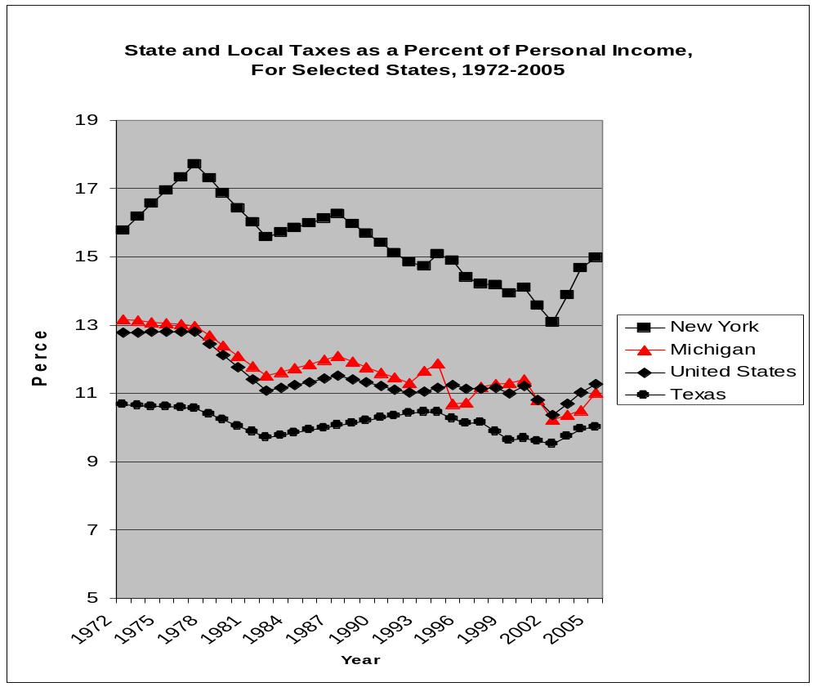
Tax Effort Has Reduced Substantially

Slide 16
Why Have Michigan Taxes Decreased as a Percent of Income?
Reduced Rates in Income Tax (until 2007) and Single Business Tax
Erosion of Tax Bases in Sales Tax, Income Tax, and Taxes on Beer & Wine

Slide 17
Our Responses to Declining Tax Revenues Have Been Questionable
Spending Cuts in Education and Revenue Sharing (But Few in Corrections).
One-Time Gimmicks.
Using Up and Selling Assets.

Slide 18
What Does Michigan Need?
1. Better Attitudes
A Culture of Lifelong Learning
Innovation and Entrepreneurship
A Positive Attitude, to Keep Going Through Difficult Times
An End to Bitter Partisanship in Lansing

Slide 19
What Does Michigan Need?
2. Better Policies
Stable Funding for K-16 Education
A Graduated Income Tax with an Earned Income Tax Credit (which means rejecting the “Fair” Tax)
Stabilize the Other Parts of the Tax System (which may mean eliminating business taxes)
An End to Legislative Gerrymandering

Slide 20
Conclusion
Michigan’s Economic Future Can Be Bright, But Only If We Make Changes.
Even if a Brighter Future Does Arrive, It Will Take Time.

